Slide 1

Modern Control Theory
Lecture No. 22
The Particle Filter Overview & Algorithm
Comparative Assessment of Particle Filters, vis-à-vis Kalman Filters

Slide 2
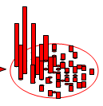
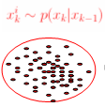
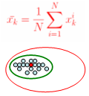



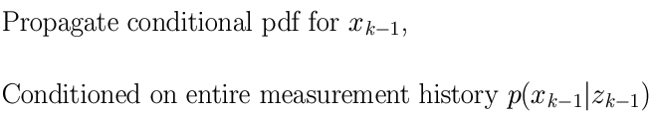
Particle Filtering --- Similar Recursions, but with a Difference
Instantiating
Re-sampling
X(k) = f[x(k-1), Bu(k-1)] + w(k-1)
Update
(k-1)+
(k)-
(k)+
k-1
k
z(k-1)
z(k)
X(k) = Ax(k-1) + Bu(k-1)

Slide 3

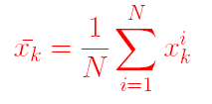



Sequential Importance Re-sampling/Particle Filter

Slide 4

Initialisation, t = 0; (Prior Step)
For i = 1, …., N, sample x(0) ~ p{x(0)} & set t = 1
Importance Sampling
  Prediction Step
  For i = 1,…,N, sample x(t,i) ~ p{x(t)|x(t-1, i)}
  Likelihood Step
  For i = 1,…,N, evaluate importance weights : w(t,i) = p{z(t)|x(t,i)
  Normalise the Importance Weights
Selection
  Update Step/Resampling Step
  Resample with replacement, according to Importance Weights
  Set t = t + 1 and return to Prediction Step

Slide 5
Prior
For a state vector of dimension (1 x 1)
    x(:,1) = sqrt(P0) * randn(N,1)
    We obtain N samples (particles)
For a state vector of dimension (n x 1)
    L = cholesky (P0)
    x = randn(N, n) * L + ones(N, n) * x (n x 1)
    We obtain x of order (N x n)

Slide 6
Initialisation, t = 0; (Prior Step)
For i = 1, …., N, sample x(0) ~ p{x(0)} & set t = 1
Importance Sampling
  Prediction Step
  For i = 1,…,N, sample x(t,i) ~ p{x(t)|x(t-1, i)}
  Likelihood Step
  For i = 1,…,N, evaluate importance weights : w(t,i) = p{z(t)|x(t,i)
  Normalise the Importance Weights
Selection
  Update Step/Resampling Step
  Resample with replacement, according to Importance Weights
  Set t = t + 1 and return to Prediction Step

Slide 7
Prediction
For a state vector of dimension (1x1)
    w ~ sqrt (Q) * randn(N,1)
    x(k-) = fn. { x, u } + w
    We obtain predicted x as (N x 1) vector
For a state vector of dimension (n x 1)
    w ~Cholesky (Q) * randn(N x n)
    For i = 1 to N,
      x1(k-) = fn. {x, u} + w(i, 1)
      :
      xn(k-) = fn. {x, u} + w(i, n)
    We obtain predicted x as (N x n) vector
k-1
k
k+1

Slide 8
Initialisation, t = 0; (Prior Step)
For i = 1, …., N, sample x(0) ~ p{x(0)} & set t = 1
Importance Sampling
  Prediction Step
  For i = 1,…,N, sample x(t,i) ~ p{x(t)|x(t-1, i)}
  Likelihood Step
  For i = 1,…,N, evaluate importance weights : w(t,i) = p{z(t)|x(t,i)
  Normalise the Importance Weights
Selection
  Update Step/Resampling Step
  Resample with replacement, according to Importance Weights
  Set t = t + 1 and return to Prediction Step

Slide 9

Likelihood/Importance Weights
Considering an Exponential pdf
    v = z* ones(N x 1) – C * x (predicted)
        (1 x n) (n x N)
    For i = 1 to N
Normalising the Weights
    For i = 1 to N
      Wt (i) = q(i) / sum(q)

Slide 10
Initialisation, t = 0; (Prior Step)
For i = 1, …., N, sample x(0) ~ p{x(0)} & set t = 1
Importance Sampling
  Prediction Step
  For i = 1,…,N, sample x(t,i) ~ p{x(t)|x(t-1, i)}
  Likelihood Step
  For i = 1,…,N, evaluate importance weights : w(t,i) = p{z(t)|x(t,i)
  Normalise the Importance Weights
Selection
  Update Step/Resampling Step
  Resample with replacement, according to Importance Weights
  Set t = t + 1 and return to Prediction Step

Slide 11



Resampling
Dist. Of
Predicted States
Corresponding
Weights
Posterior Density
Function after
Re-sampling
Particles having
Low Weights
are Rejected &
Particles having
High Weights
are Retained/
Replicated
Shape of the Density
Function before
Re-sampling
(Predicted Estimates)
Shape of the Density
Function after
Re-sampling
(Updated Estimates)

Slide 12
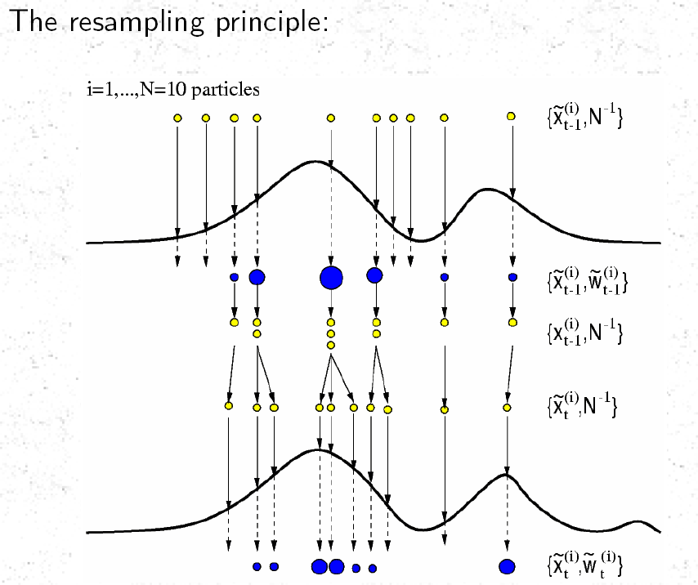

Observations, Y
Weights, w_{i}

Slide 13
Initialisation, t = 0; (Prior Step)
For i = 1, …., N, sample x(0) ~ p{x(0)} & set t = 1
Importance Sampling
  Prediction Step
  For i = 1,…,N, sample x(t,i) ~ p{x(t)|x(t-1, i)}
  Likelihood Step
  For i = 1,…,N, evaluate importance weights : w(t,i) = p{z(t)|x(t,i)
  Normalise the Importance Weights
Selection
  Update Step/Resampling Step
  Resample with replacement, according to Importance Weights
  Set t = t + 1 and return to Prediction Step

Slide 14
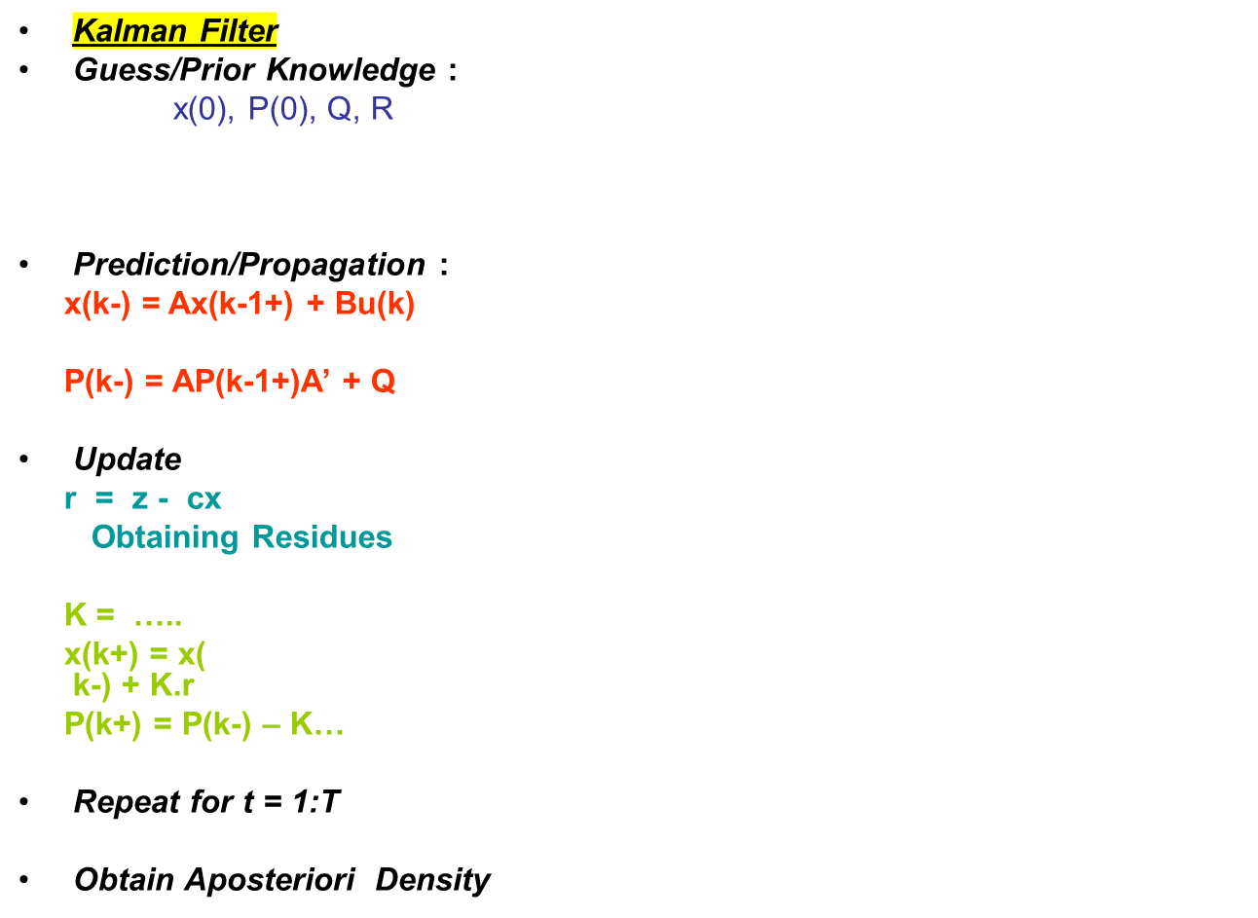
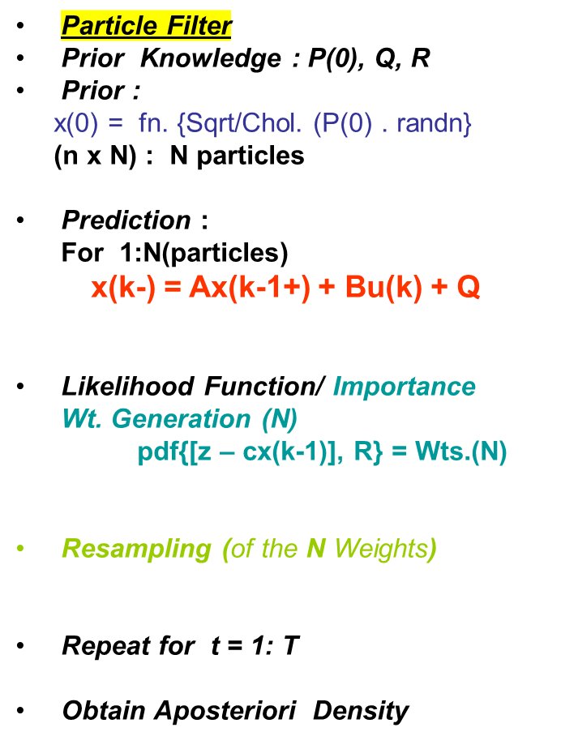
Comparing Particle Filter and Kalman Filter

